Slide 1
It’s Déjà Vu All Over Again
20 May 2010

Slide 2
Natural Gas Displaced Coal
—and Can Do It Again

Slide 3
Electric Generation
There’s Already a Lot More Gas Capacity Than Coal Available Today...
…But Natural Gas Accounts for Only 21% of the Nation’s Electricity
Generation Capacity
2008 Electric Generation
(GW)
Natural Gas 454
Coal 337
Nuclear 106
Other 206
Total 1,103
Source: EIA

Slide 4
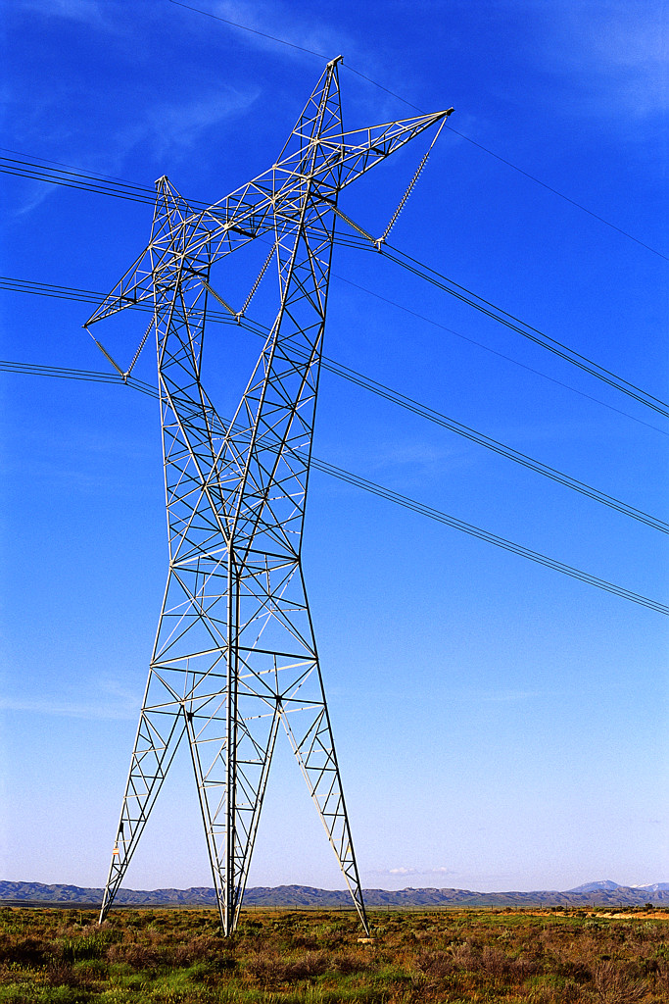
For Potential Growth, the Math is Simple
9 Gigawatts of Growth Annually
+
6 Gigawatts of Retirements Annually
15 Gigawatts per Year of New Electric Generation
That’s Only 2.3 Bcf/d of New EG Gas Demand per Year

Slide 5
The Big Six
Haynesville
Fayetteville
Marcellus
Woodford
Eagle Ford
Barnett
  Declining Existing Production
Over the course of 5 years, production will climb from 10 Bcf/d
To somewhere between
25 and 35 Bcf/d

Slide 6
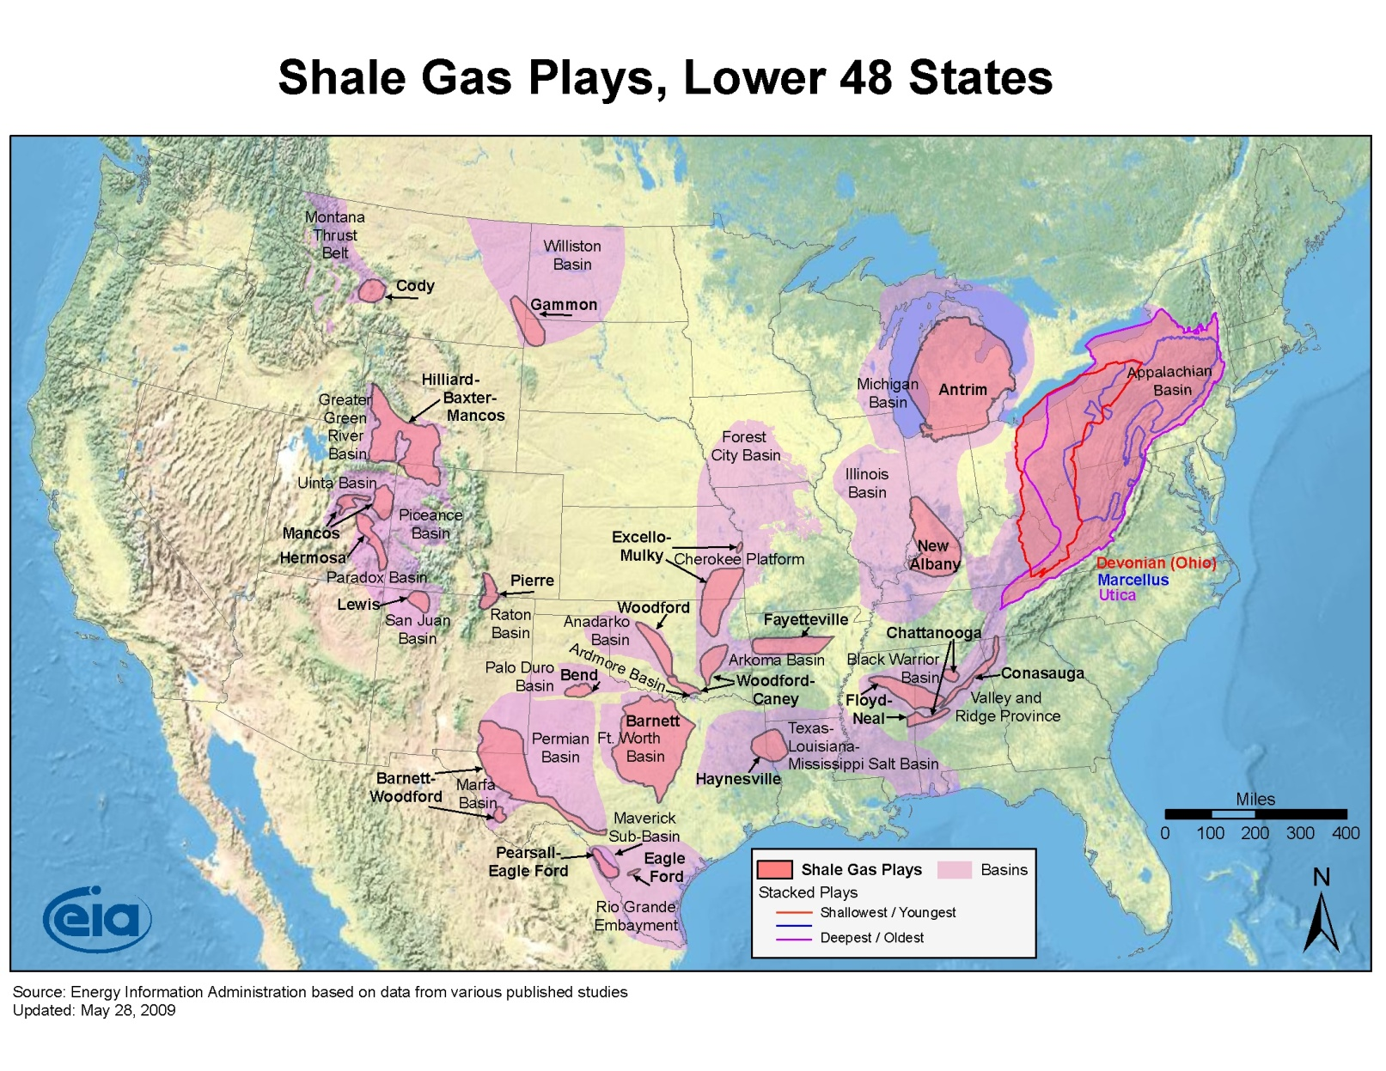
There’s much more gas out there
75 Shales

Slide 7
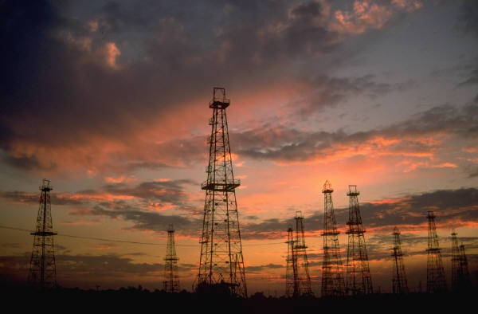
Very Predictable Supply
Production ⬄ Wells Drilled ⬄ Rig Count
  Success ratio
  Recoverable reserve size
  Producer expectations,
  obligations, hedges
  and liquids carry
In 2009 State of the Market
Report, FERC says that the
huge gas supply rally
seems sustainable
…but there is some HISTORY

Slide 8

Perceptions of Coal…
Give gas industry an edge because we match up well against coal’s good qualities
Seen as:
  Dirty
  Hard on the environment
  Low-cost
  Reliable
  Domestic
  Jobs
But Gas Offsets Supposed Advantages

Slide 9
Willie Underwood
VP, Commercial Operations
CenterPoint Energy Gas Transmission Co. (“CEGT”)
713-207-5127
Willie.Underwood@CenterPointEnergy.com
Reliable services. People you trust.

